Slide 1
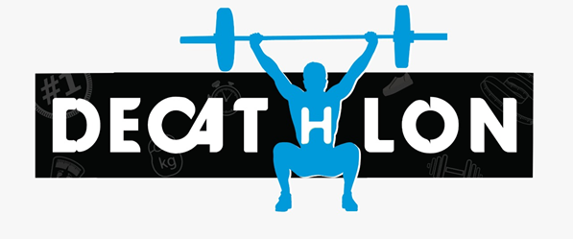
IDENTITY STYLE GUIDE
Decathlon

Slide 2
CONTENT
Introduction
The Logo
Logo Size
Colour Palette
Tagline

Slide 3
Introduction
Decathlon is one of the largest sports equipment retailer in the market. It is a one stop shop for buying sports goods online or offline, Decathlon Leeds provides a huge variety of equipment ranging from adventure sports like trekking, camping, to competitive sports like track and field, tennis etc. As a digital media student looking at the logo, I believe that it doesn’t quite capture the attention of people and can be improved a lot.
With all this in mind I decided to create a logo that looks appealing to the eye and explains a bit about what the brand is about.

Slide 4

THE LOGO
BEFORE AFTER
The logo should always have been one which explains what the brand is about and the products it sells.

Slide 5
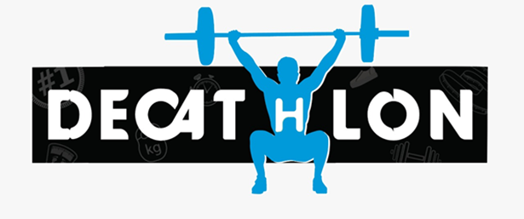
LOGO SIZE
The width of the logo is 7.9 cm and the length is 3.5 cm. The size of the logo should be easily visible to the naked eye. However, there is no bound of maximum size of the logo.

Slide 6
COLOUR PALETTE
The colour of the logo is quite simple but attractive, black, white, blue and grey are the colours I chose for the logo.
Black- 020202
Grey- 9F9F9F
Blue- 0099D8

Slide 7
TAGLINE
All for one, one for all is a simplified version of the tagline that already exists. The tagline is short which makes it catchier, which is one of the basis property of a good tagline.

